Slide 1

Rockbuster Movie Rental Analysis Project
Data Dictionary

Slide 2
OVERVIEW
This document serves as a data dictionary for the Rockbuster database, which is structured as a snowflake schema to manage and store information for a video rental business. The database encompasses details about films, actors, inventory, rentals, payments, and other related aspects.
This snowflake schema design, with fact tables at the center, surrounded by dimension tables, which are then surrounded by sub-dimension tables, allows for efficient data storage and querying. The relationships between the tables enable complex data analysis and reporting for the video rental business.

Slide 3
TABLE OF CONTENTS
Cover page………………………………………………………………………………………………………………………..1
Overview…………………………………………………………………………………………………………………………..2
ERD(Entity Relationship Diagram)……………………………………………………………………………………..4
Fact Tables…………………………………………………………………………………………………………………………5
Dimension Tables……………………………………………………………………………………………………………….7

Slide 4
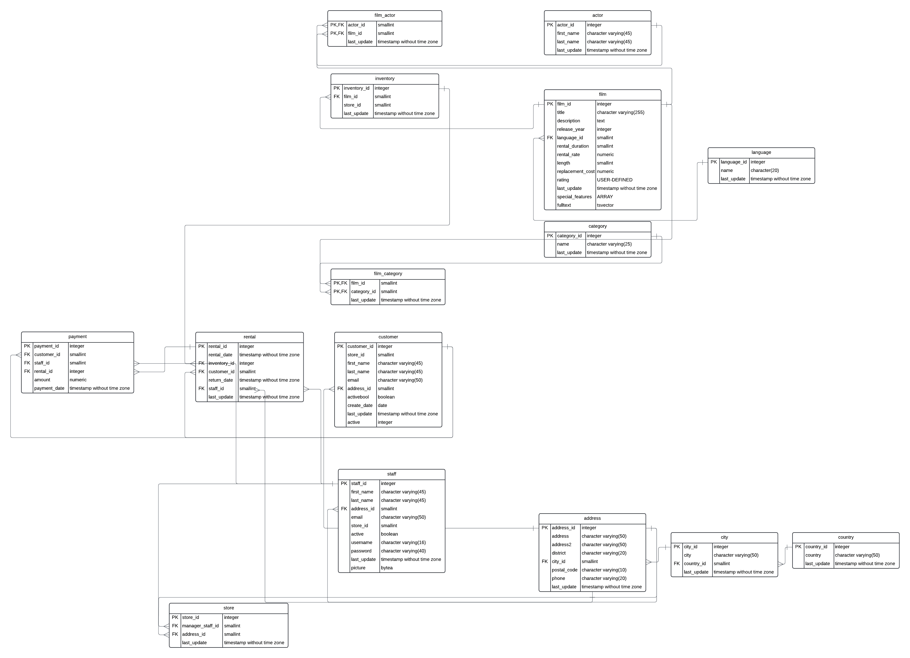
ENTITY RELATIONSHIP DIAGRAM(ERD)

Slide 5
FACT TABLES
Rental Payment
column | Data type | Description | Links
rental_id (PK) | integer | Primary key, unique identifier for each rental. | Payment
rental_date | Timestamp without time zone | Date and time when the rental was made.
inventory_id (FK) | Integer | Foreign key, links to the inventory table | Inventory
customer_id (FK) | Smallint | Foreign key, links to the customer table. | Customer
return_date | Timestamp without time zone | Date and time when the rental was returned.
staff_id (FK) | Smallint | Foreign key, links to the staff table. | Staff
last_update | Timestamp without time zone | Timestamp of the last update to the rental.
column | Data type | Description | Links
payment_id (PK) | Integer | Primary key, unique identifier for each payment
customer_id (FK) | Smallint | Foreign key, links to the customer table. | customer
staff_id (FK) | Smallint | Foreign key, links to the staff table. | staff
rental_id (FK) | Integer | Foreign key, links to the rental table. | rental
amount | Numeric | Amount of the payment.
payment_date | Timestamp without time zone | Date and time of the payment.

Slide 6
DIMENSION TABLES
Actor Address
column | Data type | Description | Links
actor_id (PK) | Integer | Primary key, unique identifier for each actor. | Film_actor
first_name | character varying(45) | First name of the actor.
last_name | character varying(45) | Last name of the actor.
last_update | timestamp without time zone | Timestamp of the last update to the actor's information.
column | Data type | Description | Links
address_id (PK) | integer | Primary key, unique identifier for each address. | customer store staff
address | character varying(50) | First line of the street address.
address2 | character varying(50) | Second line of the street address (optional).
district | character varying(20) | District or region of the address.
city_id (FK) | smallint | Foreign key, links to the city table. | city
postal_code | character varying(10) | Postal code for the address.
phone | character varying(20) | Phone number associated with the address.
last_update | timestamp without time zone | Timestamp of the last update to the address.

Slide 7
Category Country
column | Data type | Description | Links
category_id (PK) | Integer | Primary key, unique identifier for each category. | Film_category
name | character varying(25) | Name of the category.
last_update | timestamp without time zone | Timestamp of the last update to the category.
column | Data type | Description | Links
country_id (PK) | Integer | Primary key, unique identifier for each country. | city
country | (character varying(50) | Name of the country.
last_update | timestamp without time zone | Timestamp of the last update to the country.
City
column | Data type | Description | Links
city_id (PK) | Integer | Primary key, unique identifier for each city. | address
city | character varying(50) | Name of the city.
country_id (FK) | smallint | Foreign key, links to the country table. | country
last_update | timestamp without time zone | Timestamp of the last update to the city.

Slide 8
Customer Film
column | Data type | Description | Links
customer_id (PK) | integer | Primary key, unique identifier for each customer. | Rental payment
store_id (FK) | smallint | Foreign key, links to the store table. | store
first_name | character varying(45) | First name of the customer.
last_name | character varying(45) | Last name of the customer.
email | (character varying(50) | Email address of the customer.
address_id (FK) | smallint | Foreign key, links to the address table. | address
activebool | boolean | Indicates if the customer is currently active.
create_date | date | Date when the customer was created.
last_update | timestamp without time zone | Timestamp of the last update to the customer's information.
active | integer | Additional field indicating active status (1 for active, 0 for inactive).
column | Data type | Description | Links
film_id (PK) | integer | Primary key, unique identifier for each film. | Film_actor Film_category inventory
title | character varying(255) | Title of the film.
description | text | Description of the film.
release_year | integer | Year the film was released.
language_id (FK) | smallint | Foreign key, links to the language table. | language
rental_duration | smallint | Rental duration in days.
rental_rate | numeric | Rental rate for the film
length | smallint | Length of the film in minutes.
replacement_cost | numeric | Cost to replace the film if lost.
rating | USER-DEFINED | Rating of the film (e.g., G, PG, PG-13, R, NC-17).
last_update | timestamp without time zone | Timestamp of the last update to the film's information.
special_features | ARRAY | List of special features included with the film.
fulltext | tsvector | Full-text search vector for the film's information.

Slide 9
Film_actor Film_Category
column | Data type | Description | Links
actor_id (PK,FK) | Smallint | Primary key, foreign key linking to the actor table. | actor
film_id (PK,FK) | Smallint | Primary key, foreign key linking to the film table. | film
last_update | Timestamp without time zone | Timestamp of the last update to the film-actor relationship.
column | Data type | Description | Links
film_id (PK,FK) | Smallint | Primary key, foreign key linking to the film table | film
category_id (PK,FK) | Smallint | Primary key, foreign key linking to the category table | category
last_update | Timestamp without time zone | Timestamp of the last update to the film-category relationship.
Inventory
column | Data type | Description | Links
inventory_id (PK) | integer | Primary key, unique identifier for each inventory item. | rental
film_id (FK) | Smallint | Foreign key, links to the film table | film
store_id (FK) | Smallint | Foreign key, links to the store table. | store
last_update | Timestamp without time zone | Timestamp of the last update to the inventory item.

Slide 10
Language Staff
column | Data type | Description | Links
language_id (PK) | integer | Primary key, unique identifier for each language. | film
name | character varying(20) | Name of the language.
last_update | timestamp without time zone | Timestamp of the last update to the language.
column | Data type | Description | Links
staff_id (PK) | integer | Primary key, unique identifier for each staff member. | Rental Payment store
first_name | character varying(45) | First name of the staff member.
last_name | character varying(45) | Last name of the staff member.
address_id (FK) | smallint | Foreign key, links to the address table. | address
email | character varying(50) | Email address of the staff member.
store_id (FK) | smallint | Foreign key, links to the store table. | store
active | boolean | Indicates if the staff member is currently active.
username | character varying(16) | Username for the staff member.
password | character varying(40) | Password for the staff member.
last_update | timestamp without time zone | Timestamp of the last update to the staff member's information.
picture | bytea | Picture of the staff member.
Store
column | Data type | Description | Links
store_id(PK) | integer | Primary key, unique identifier for each store. | Inventory staff
manager_staff_id (FK) | smallint | Foreign key, links to the staff table (manager of the store). | staff
address_id (FK) | smallint | Foreign key, links to the address table. | address
last_update | timestamp without time zone | Timestamp of the last update to the store.
FK – Foreign key
PK – Primary key
Links to
Linked from

